Slide 1
AGENDA H
BEDFORD STUYVESANT RESTORATION CORP
TEAM BUILDING TRAINING SESSION 5 January 18 2019
:
 | Learning Activity
1 | Gather Center Check In
2 | Feedback
3 | Session 5: Goals and Objectives
4 | Presentations Work Agreement
5 | Authentic Leadership Review
6 | Communication and Polarity Thinking
7 | Summary

Slide 2
check - in
breathe

Slide 3
Session Four Goals and Objectives
Goal: Embrace power of communication, conflict and connecting to discover how to learn from it
Objectives:
1. Apply understanding of leadership tools to current organizational challenges
2. Enhance strategies for managing complex adaptive change in the workplace
3. Discern the relationships necessary to peak performance
4. Increase diversity of approaches to work together across and within sites

Slide 4
feedback
what went well
what didn’t go so well

Slide 5
our purpose

Slide 8
The Community we want to Become H
Attentive
Listen to each other
Cooperative
Trustworthy
Organized
Clear
Accountable
Respected
Holistic
Collaborative
Consistent
Ethical
Integrity
Patience
Effective
Welcoming
Transparent
Transforming
Productive
Dedicated

Slide 9
The Community We Want to Become H
Inspiring
Successful
Solution oriented
Empathetic
Empowering
Stress free
Communication

Slide 10
Community Norms H
Self Control
Seeking Clarity
Loosen Up
Leave titles at the Door
Empathy with each other
Use “I” statements
Recommended: “Gossip Free Zone Policy”- Share freely and no retaliation or story changing
Recommended What happens in this room stays here- not shared with people not in retreats

Slide 11
HOMEWORK Assignment due January 18th , 2019
1. Meet with another Unit Team and share your “Work Agreements for your Team” and Work Agreements for your site” DONE-REFINE BY JAN 25
2. Review your completed Leadership Development Plan (LDP) form that was given to you from leadership (if you did not receive one, please download and complete one from drbanksatplay.com website) SEND TO SONIA AND BRING JAN 25TH
3. Bring your completed LDP and both the Team Work Agreement and Site Work Agreement to the January 25th meeting with any revised or additional suggestions for Retention Plan per unit follow up as needed

Slide 12
Start Inside Yourself First
How do we become the community we need to be inside out?

Slide 13
authentic leadership
The roots of authentic leadership come from ancient Greek philosophy that focuses on the development of core, or cardinal, virtues. These virtues are Prudence (fair-mindedness, wisdom, seeing all possible courses of action), Temperance (being emotionally balanced and in control), Justice (being fair in dealings with others), and Fortitude (courage to do the right thing).

Slide 14
authentic leadership
Q1. Self-Awareness (“Know Thyself”). A prerequisite for being an authentic leader is knowing your own strengths, limitations, and values. Use 3 index cards and write one strength – one limitation – one value. Share with team about how you could use it better or differently to increase retention.

Slide 15
authentic leadership
Q2. Relational Transparency (“Be Genuine”). This involves being honest and straightforward in dealing with others. When do you put a mask on or push out a false self? What is it costing you? What does it cost the company?

Slide 16
authentic leadership
3. Balanced Processing (“Be Fair-Minded”). An effective authentic leader solicits opposing viewpoints and considers all options before choosing a course of action. There is no impulsive action or “hidden agendas”–plans are well thought out and openly discussed. What stops you from asking for and listening to and integrating opposing views?

Slide 17
authentic leadership
4. Internalized Moral Perspective (“Do the Right Thing”). An authentic leader has an ethical core. She or he knows the right thing to do and is driven by a concern for ethics and fairness. How do we balance this part of ourself with what the work demands of us?

Slide 18
authentic leadership
The Creative and Reactive Orientations to Tension in Teams and Decision Making
---------------------------------------------------------------
What impacts team building?
moving toward (complying)
moving against (controlling)
moving away (protecting)

Slide 19
we balance creative & reactive work approaches

Slide 20
Reactive
When I’m in the throws of a reactive response:
1. What does it feel like is happening?
2. What do I say to myself about myself, other people and the way things work around here?
3. What do other people observe about me?
4. What is it that I want to create, that matters so much to me that I’ll do anything to bring it into being?
5. What would best help propel me
towards the creation of that team vision?

Slide 21
What Reactive responses, if over done, disable teams?
Reactive
• Caution over creating results,
self-protection vs. productive engagement
and aggression building alignment
• Over emphasize the focus on gaining approval
of others, protecting yourself and getting
results through control tactics and you are in a reactive tension

Slide 22
Exploring the impact on our work: of the stories we tell ourselves
What stories in your head /assumptions/beliefs/or values impact what you do at work?
SHARE WHAT IT WAS LIKE TRYING TO WRITE DOWN THE STORY IN YOUR HEAD

Slide 23
People and Task

Slide 24
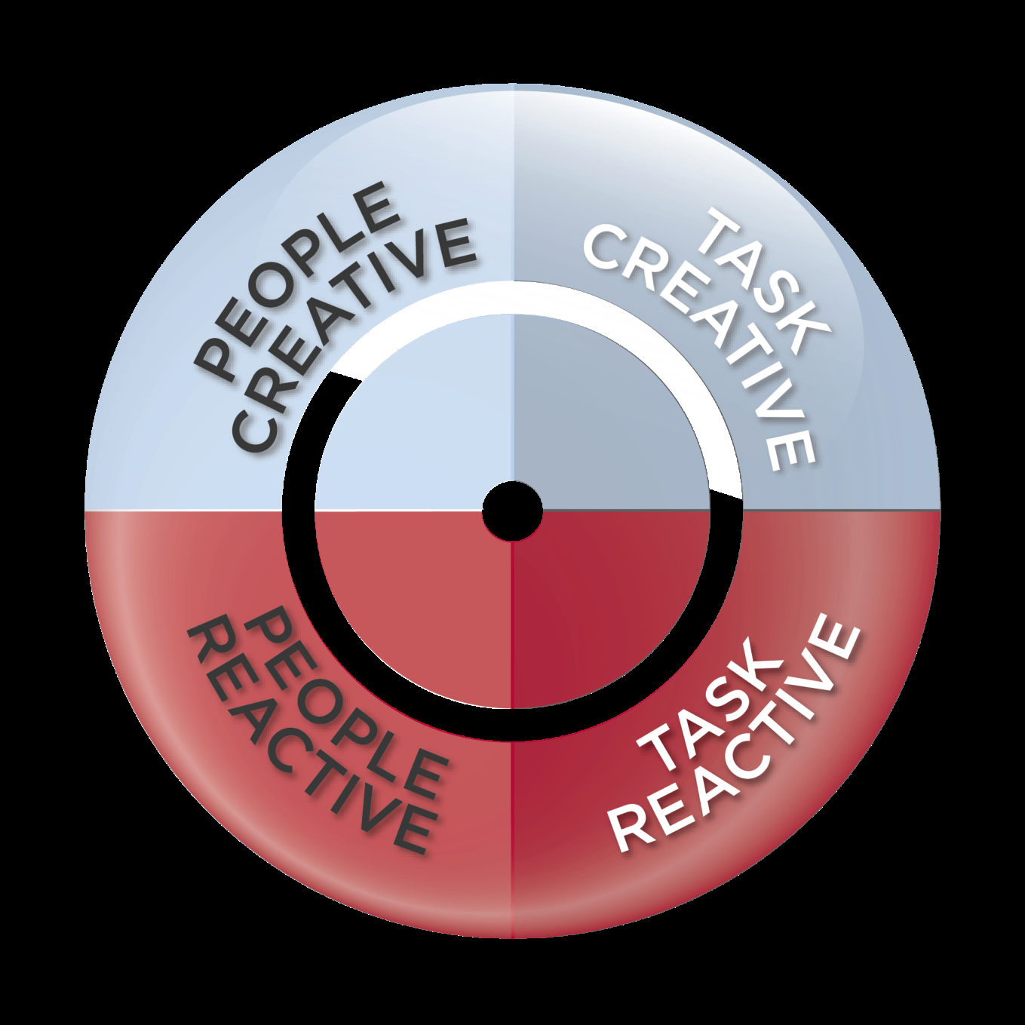

Slide 25
So what is “building your teams”?
How you achieve results, bring out the best in
others, enhance your own development, act with integrity and courage and improve systems

Slide 26
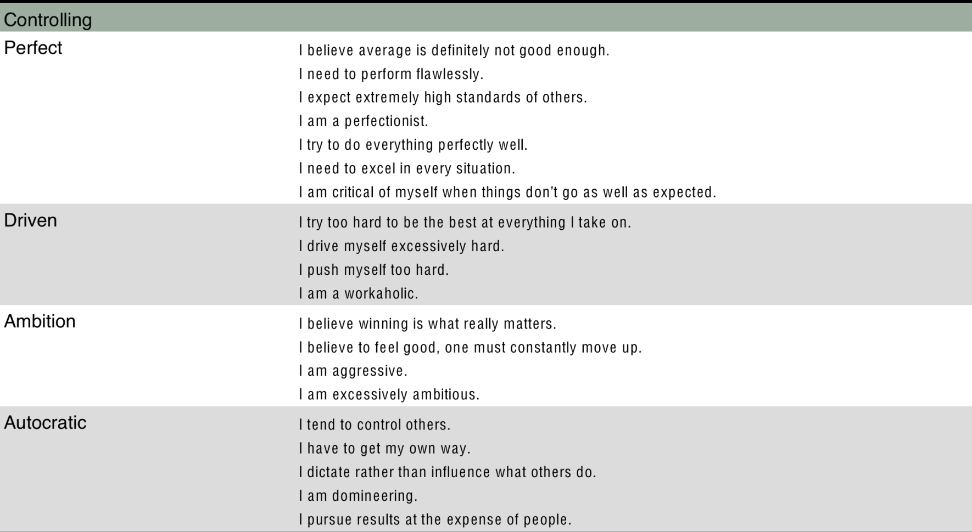
What are workplace reactive tendencies?

Slide 27
what do you tell yourself when your reactive side is triggered?
• I’m not valued here
• No need in sharing my thoughts as they are not well received
• I’ll focus on what I believe is best
• Might as well just work individually
• I don’t want to be the only one making this point again

Slide 28
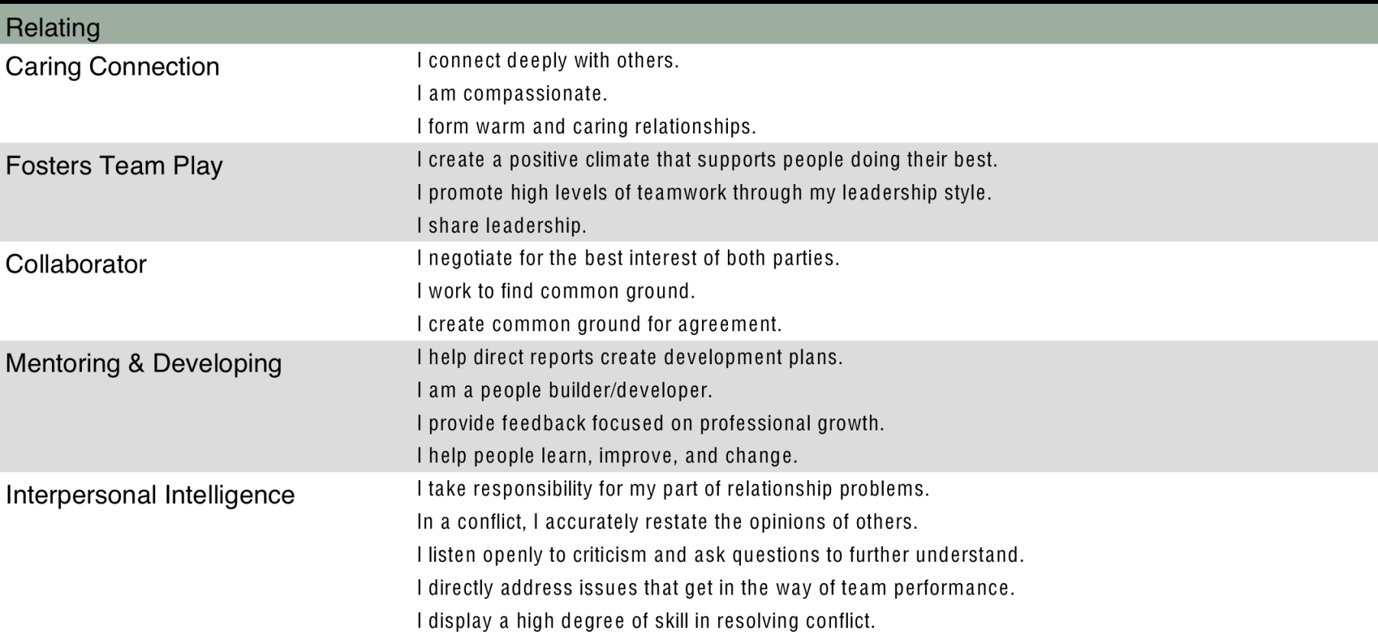
What are workplace creative tendencies ?

Slide 29
what do you tell yourself when your creative side is at work?
what is dramatically different about what you tell yourself when you are in a reactive tension ( CONTROLLING, COMPLYING OR PROTECTING YOUR POINT OF VIEW) vs a MORE creative tension ( CARING, FOSTERS TEAM PLAY, COLLABORATIVE, MENTORING AND DEVELOPING) at work?

Slide 30
How do you Change Your Stories/Beliefs/Assumptions?
Old Story
New Story
my value in this debate equals my value
if I am the black hat all the time I no longer am heard
If I don’t get it perfect, bad things will happen
If I have to ask for help, it means I am weak
If I want it done right, I must do it myself
I am enough even when my point is overlooked
My authentic voice, no matter how messy, connects me to my team’s purpose
We can create more together than I ever could on my own
I am a work in progress and I am valued

Slide 31
Conversations

Slide 32
communication is situational.
understanding is psychological
•Communication is situational. Think of a situation that impacted how you communicated.
•Trying to understand what is being said however is psychological.
•It involves a back and forth dialogue where there is a shifting of mindsets
• How often do we allow for a shift in our perspective or support the time needed to understand?

Slide 33
what is impacted by communication?
Physical needs are affected by communication, as its presence or absence affects physical health.
identity needs are met through communication, which is the major way we learn who we are as humans.
Social needs are met through communication, as it is the principle way relationships are created.
Practical needs are met through communication every day, as it serves important functions e.g. instruction.

Slide 34
A Formula for Authentic Conversations
Compassion for another’s beliefs, values, assumptions and their perspective - story
+
Undefended Presence - there is no fight
+
Courage - I am enough to move this forward
=
Connection

Slide 35
Sit in your site groups
TWO questions
• Ask yourself, “How am I just like that quality or behavior that I don’t like in the other person”
• Ask yourself, “How have I contributed to the situation, and what will I commit to doing differently going forward?”

Slide 36
What happens when you are having conversations within the team or other teams?
Courage
Are you:
– Probing beyond the surface or first response
– Getting it wrong
– Giving up being right
– Seeking disapproval/disagreement
– Being open to influence or a new perspective
– Getting emotional

Slide 37
Having Courageous Conversations is a Both And Proposition
https://youtu.be/5O11_Ma20Rk
<iframe width="560" height="315" src="https://www.youtube.com/embed/5O11_Ma20Rk" frameborder="0" allow="autoplay; encrypted-media" allowfullscreen></iframe>

Slide 38
think of a conversation you want
to do-over
close or lower your eyes
think of a conversation you want to have over again
consider what you intended
consider what you heard
consider what you said
what would you do differently? share with the group.

Slide 39
begin to practice with someone h
“Speaker”
Think: What is my intention, what do I want, value, envision or hope for from
this conversation? (and what do I not want)
Say: What I notice about current reality is...
My commitment or intention (because
I’ve identified how I contributed to the
situation) is..
“Listener”
What I’m hearing you say is..
What I notice in myself as I hear it..
Think: What I will look at, and what I choose not to take on is..
Say: My response to your request
(yes, no, counter offer)

Slide 40
Unit Meeting and Work Agreements
Asset building
Customer Service & Outreach
Workforce Development
Education & Training
General
Social Services

Slide 41
a series of communication possibilities await us at each conversation

Slide 42
no longer misunderstand
understood
Communication: Collaborative Efforts: If you’re working on a team project, and the team leader has not defined the shared expectations of team roles, missed deadlines, finger pointing and blame can the result. Does this ever happen? What is being misunderstood? WHAT WORK AGREEMENT WILL HELP US.

Slide 43
no longer misunderstand
understood
Communication: Unchecked Gossip: If rumors are circulating through your office, people may start to worry, doubt the future, or have concerns they’re being talked about or portrayed in an unflattering light. What is the team impact of someone being misunderstood?
WHAT WORK AGREEMENT WILL HELP US

Slide 44
no longer misunderstood
understand
Communication: Following Up and Closing loops: When one program or site fails to coordinate with another program or site on a major project, the result can be a degree of miscommunication that not only derails progress but also leads to conflict.
Anytime you have cross-departmental work going on - what needs to happen to limit misunderstanding? WHAT WORK AGREEMENT IS NEEDED TO HELP US?

Slide 45
no longer misunderstood
understand
Setting Clear Communication Policies: One way to combat miscommunication that leads to conflict is to establish clear communication policies for your ONE COMMON BEDSTUY TRAINING GOAL ASSIGNMENT:RETENTION
PLEASE ADVISE WHAT WORK AGREEMENT CAN HELP.

Slide 46
no longer misunderstand
understood
Communication: Country of Meeting Actions Documented? Shared? Read? Are we being transparent with what is going on? Do you have a format for how meeting goals,responsibility should be recorded, reviewed and followed up. What is needed? PLEASE ADVISE WHAT WORK AGREEMENT CAN HELP?

Slide 47
no longer misunderstood
understand
Communication: Country of Project updates.Much like establishing guidelines for documenting meeting outcomes, how do you provide regularly scheduled project updates to each other? PLEASE ADVISE inhabitants of this country. WHAT WORK AGREEMENT CAN HELP US?

Slide 48
DOES DISCOMFORT STOP US?
EXPLAIN HOW
EXPLAIN WHEN
EXPLAIN WHAT KIND OF DISCOMFORT IMPACTS US

Slide 49
What if you could turn difficult situations into conversation breakthroughs?
Some argue we have to EXIT comfort and ENTER discomfort TO STICK TO WORK AGREEMENTS. Is that really necessary?
u<iframe width="560" height="315" src="https://www.youtube.com/embed/w4PhYEz_UY0" frameborder="0" allow="autoplay; encrypted-media" allowfullscreen></iframe>
uhttps://youtu.be/w4PhYEz_UY0

Slide 50
WHAT DID YOU NOTICE?
PLEASE HAVE A TABLE CONVERSATION ABOUT WHAT YOU
NOTICED
UNDERSTOOD
ABOUT THE DISCOMFORT ZONE
NOW CONSIDER WHICH HAT STEPS IN AND OUT OF THAT ZONE THE MOST AND WHY?

Slide 51
What happens when we are successful at communicating something really important AND DIFFICULT?
1. INNOVATION: We consider another way.
2. DISCIPLINE: NO ONE feels ambushed
3. RELIEF: We talked about “the elephant in the room”.
4. STRATEGIC: All the possible options have been openly raised.
WHAT ELSE?

Slide 52
If you are not ready to start THE CONVERSATION in your head…YOU MAY MISS THE BENEFITS OF TEMPORARY DISCOMFORT
May not be ready to explore core beliefs of the change
May not feel this is important
May not think you will directly change or impact the success or outcome - bit by bit
May be pre-occupied (overwhelmed/stressed at the moment) with other changes competing for attention
May be fearful (worried about what they have to face about their self) or the CONSEQUENCES OF THE CONVERSATION OUTWEIGH THE BENEFIT.CHECK THIS OUT WITH SOMEONE ELSE. WHAT MAKES YOU PULL BACK?

Slide 53
CONVERSATION STARTERS
You’ll want to use language that indicates that the two of you need to work things out together.
Here are some examples of how you might communicate your concerns:
“There’s a problem that you and I share. We’ve both let this linger; I hope we can work through this together.”
“Things have fallen apart around this issue. In the meantime, just know how much I respect and trust you and so I don’t want us to act as if our problem doesn’t exist – it could make this harder. “
“Id like to visit our last conversation. How we can talk through this without guilt or blame.”
“I’m concerned that there are issues we haven’t talked about that are affecting how we work together. I wonder if you have concerns about this, too.”
“Talking about this is difficult for me, but I’m hoping we can help each other to say what we need to say. “
NOW TRY USING ONE OF THESE – OR A BRIDGE BUILDER LIKE THIS AND CHECK OUT IF IT IMPACTS THE OTHER PERSON DIFFERENTLY

Slide 54
SUMMARY
WHAT DID WE LEARN?
WHAT DID WE UNLEARN?

Slide 55
What do you see when you face a complexity as a team?
Problem or Polarity?

Slide 56
Two Faces
WHAT DO YOU SEE?

Slide 57
WHAT DO YOU SEE?

Slide 58
older woman

Slide 59
half face

Slide 60
You are facing polarities. Are you still treating them as problems?
“An ongoing problem with two correct answers that are interdependent” Shoshana

Slide 61
Sparks of Light
…it is the art of balancing opposites in such a way that they do not cancel each other but shoot sparks of light across their points of polarity. It looks at our desperate either/ors and tells us they are really both/ands—that life is larger than any of our concepts and can, if we let it, embrace our contradictions. —Mary C. Morrison

Slide 62
Problem vs. Polarity
Problem
Polarity
A question or puzzle that needs to be solved
A situation in which two seemingly contradictory states are really interdependent and must be maintained for success to occur over time

Slide 63
Problem or Polarity? – Four Lenses
Is the difficulty ongoing, like breathing?
yes = probably a polarity to manage
no = probably a problem to solve
Is it a situation of moving “from” one state “to” another?
yes = probably a polarity to manage
no = probably a problem to solve
Are there two alternatives that are interdependent?
yes = probably a polarity to manage
no = probably a problem to solve
Over time, do you need the upsides of both options?
yes = probably a polarity to manage
no = probably a problem to solve

Slide 64
Polarities are
Unavoidable
Unsolvable
Indestructible

Slide 65
Problem or Polarity?
Issue | Polarity/Problem? Criteria used?
1. Where do we go for lunch? Sam likes, “Wanda’s Wonder Bar” and Linda likes, “The Nostalgic Noodle.”
2. We have to get rid of our silo mentality. Let’s break down the barriers and become and integrated team.
3. How do we get to the top of this mountain?
4. We are becoming an international organization. How do we get our people to think globally?
5. Should we go after the grant from with “Mega-Corp.?” It would certainly help meet our fundraising goals.
6. How do we get support from town councils to support the effort?
7. Our community partners have to talk to everyone before deciding. How can we get them to decide faster?
Problem
Polarity
Problem
Polarity
Problem
Problem
Polarity

Slide 66
Using a Polarity Map
Action Steps
Action Steps
Early Warnings
Early Warnings

Slide 67
Managing Polarities in 3 Steps
1 -Define the Difficulty
Include
Key
Stakeholders
2 - Build the Polarity Map
3 – Action Steps and Early Warnings

Slide 68
INTEGRATIVE PERSPECTIVE
HOW TO CAPTURE WHO WE ARE (PEOPLE), HOW WE WORK(CULTURE), WHY WE WORK (MOTIVATION) AND WHAT ENABLES THE WORK (ORGANIZATION).

Slide 69
Integrative Perspective
I you
We the culture
It our daily ways
Its our regulations and policies

Slide 70
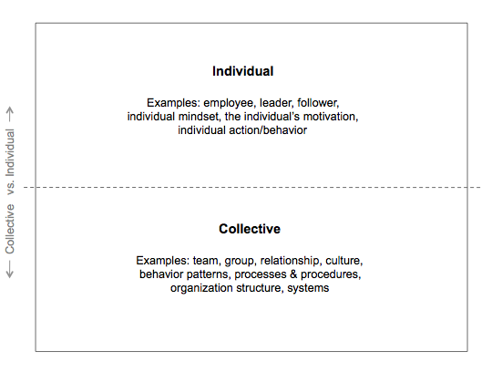
Quadrants
Team situations can be considered from the perspective of the individual or from the perspective of the collective (the group, team or organization).

Slide 71
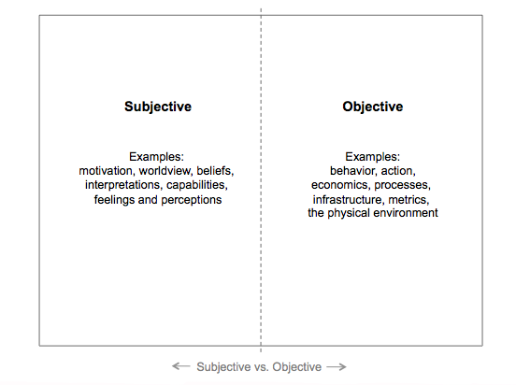
Every phenomenon can be considered from an objective or a subjective point of view

Slide 72
“I” Thinking
What does the “I” quadrant mean YOU need to do from your perspective to advance the mission and purpose of our work?

Slide 73
“We” Thinking
What does the “WE“ thinking need to be to support the mission and specifically retention initiatives across teams and sites?

Slide 74
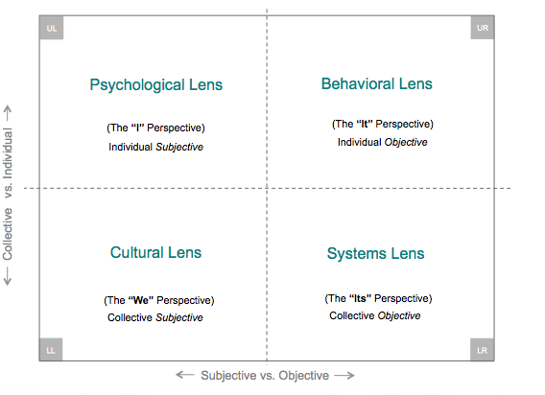
By simply bringing together the individual and collective on one axis and subjective and objective on another axis,
we have four quadrants. These quadrants represent universal perspectives. They are irreducible, meaning that you can not collapse one into the other and simply pretend that those dimensions
do not exist.

Slide 75
Now think about “it” and “its”
How will how we take on this change we discussed (our retention strategies and work agreements) impact our daily ways of behaving and our policies?

Slide 76
What is this Retention Project’s Story Going to Be ?
Think about the proposed retention focus. Think about what you believe it will take from all four quadrants. Green Hats to Yellow Hats. Red Hats to Blue Hats
Internal
External
Motivators
Individual values and beliefs
Thoughts and emotions
Meaning-making
Intellect
Upper Left
Behaviors
Individual actions
Task performance
What people see you do
Upper Right
Individual
Culture
Group values and ethics
Work climate
Group norms, expectations, taboos
Jargon and program/department communication style
Lower Left
Organizational Structures
Rules, Regulations
Systems
Processes and Procedures
Collective Behavior
Reporting structures
Communication channels
Lower Right
Collective

Slide 77
Integral Leadership Perspective
Internal
External
Motivators
Individual values and beliefs
Thoughts and emotions
Meaning-making
Intellect
Behaviors
Individual action
Task performance
What people see you do
Individual
Personal Alignment
Values Alignment
Structural Alignment
Organizational Structures
Systems
Processes and Procedures
Collective Behavior
Reporting structures
Communication channels
Rules and Regulations
Collective
Culture
Group values and ethics
Work climate
Group norms, expectations, taboos
Jargon and program/department communication style
Department Alignment

Slide 78
How do we check out our Teams’ Integral Thinking ?
Internal
Motivators What beliefs or assumptions do you hold about this issue? Why is this issue important, why does it matter to you? How important is this issue to you on a scale of 1-10? Do you feel that you know enough? What else do you need to know? Imagine that this issue was resolved for you, how would you describe that feeling? What are you willing or not willing to do to resolve this issue? | Your Actions and Behaviors What are you currently doing to resolve this issue? What are the behaviors impacting this issue (yours or other peoples)? How is the issue impacting performance ? How are you displaying your current competencies? What do other people in your position do in this situation? What are you being told to do about this issue?
Culture Who shares concern about this issue with you? Who does not share your concern? How do your thoughts about this issue resonate with other people on your team, department etc.? What are the norms about this issue? What are the taboos? How is this issue usually talked about or dealt with? What type of resistance might you encounter in dealing with this issue? | Organizational Structures and Regulations What processes or rules can you use or follow to help with your issue? Which are getting in the way? What organizational structures are relevant to your issue and why? Hierarchies, networks, etc. With whom do you engage in activities that are relevant to your issue? What systems support or hinder? What infrastructure or other resources are essential and where do you find them?
External
Individual
Collective

